Slide 1
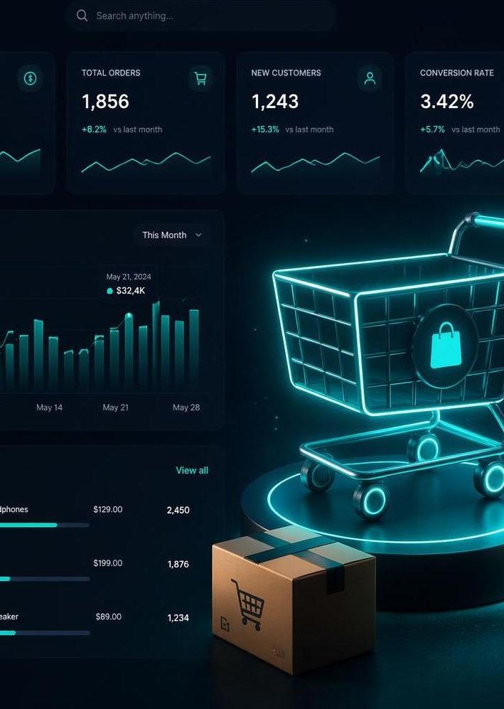
ECOMMERCE ANALYTICS · 2023–2025
Ecommerce Sales
Performance Review
Revenue, products, geography, fulfillment and payment insights across the order book.
Prepared June 16, 2026

Slide 2
EXECUTIVE SNAPSHOT
Performance at a Glance
₹57.1M
486
₹117K
1,469
TOTAL REVENUE
ORDERS ANALYZED
AVG. ORDER VALUE
UNITS SOLD
Healthy basket size. An average order value near ₹117K signals high-value electronics purchases, with steady demand spread evenly across the catalog.
Figures reflect analyzed order records with complete pricing across the 2023–2025 dataset.
Ecommerce Sales Performance Review
2

Slide 3
PRODUCT PERFORMANCE
Revenue by Product
WHAT STANDS OUT
Smart Watch leads
Tops the catalog at ₹8.8M — the single biggest revenue driver.
Accessories punch up
Chargers and mice rival monitors, showing strong add-on demand.
Long tail is even
No product falls below ₹3.7M — revenue is broadly diversified.
Ecommerce Sales Performance Review
3

Slide 4
CATEGORY MIX
Where Revenue Comes From
₹32.0M
Electronics
56% of revenue — the core engine of the business.
₹13.9M
Tech
24% — a strong secondary contributor.
₹10.9M
Gadgets
19% — a meaningful, growing slice.
Ecommerce Sales Performance Review
4

Slide 5
GEOGRAPHIC REACH
Revenue by City
₹13.4M
DELHI LEADS
≈ 23% of all revenue — the top market by a wide margin.
Metro concentration. Delhi and Mumbai together drive a third of revenue, while six other metros each contribute a steady ₹5–6M.
Ecommerce Sales Performance Review
5

Slide 6
SALES TREND
Quarterly Revenue Trajectory
2023
₹20.1M
2024
₹19.2M
2025
₹17.8M
Peak year
Slight dip
Softening
Ecommerce Sales Performance Review
6

Slide 7
ORDER FULFILLMENT
Where Orders Land
33%
of orders fail to complete
Returns (17%) and cancellations (16%) are the biggest leak in the funnel.
Only 35% reach 'Delivered'
A further 17% shipped and 15% pending leave many orders in motion. Tightening returns and speeding fulfillment is the clearest lever for revenue capture.
Ecommerce Sales Performance Review
7

Slide 8
PAYMENT BEHAVIOR
How Customers Pay
A BALANCED WALLET
No single method dominates
Every option sits within a tight 18–22% band.
Digital-first, but cash matters
UPI and cards lead, yet COD still drives 1 in 5 orders.
Low concentration risk
Balanced rails reduce exposure to any one provider.
Ecommerce Sales Performance Review
8

Slide 9

KEY TAKEAWAYS & NEXT STEPS
Turning Insight Into Action
1
Double down on Electronics & Smart Watches
Protect the 56% revenue core with stock depth and featured promotion.
2
Cut the 33% return-and-cancel leak
Audit reasons, tighten product info, and trigger save-the-sale outreach.
3
Grow beyond Delhi & Mumbai
Localized campaigns in the six steady ₹5–6M metros to balance the map.
4
Reverse the multi-year softening
2025 trailed 2023 by ₹2.3M — invest in retention and basket growth.

